Slide 1

Heaven’s light is our guide”
Rajshahi University of Engineering & Technology
Department of Computer Science & Engineering
Data Communication
Course No. : CSE 3103
Chapter 6: Bandwidth Utilization – Multiplexing and Spreading
Prepared By : Julia Rahman

Slide 2
6 Bandwidth Utilization
In real life, we have links with limited bandwidths.
Wise use of bandwidths is one of the main challenges of electronic communications
Bandwidth utilization is the wise use of available bandwidth to achieve specific goals.
Efficiency can be achieved by multiplexing; i.e., sharing of the bandwidth between multiple users.
In multiplexing, combine several channels into one.
In spreading, expand the bandwidth of a channel to insert redundancy.
Julia Rahman, Dept. CSE, RUET

Slide 3
6-1 MULTIPLEXING
If the bandwidth of a link is greater than the bandwidth needs of the devices connected to it, the bandwidth is wasted.
Whenever the bandwidth of a medium linking two devices is greater than the bandwidth needs of the devices, the link can be shared.
Multiplexing is the set of techniques that allows the (simultaneous) transmission of multiple signals across a single data link.
As data and telecommunications use increases, so does traffic.
Julia Rahman, Dept. CSE, RUET

Slide 4
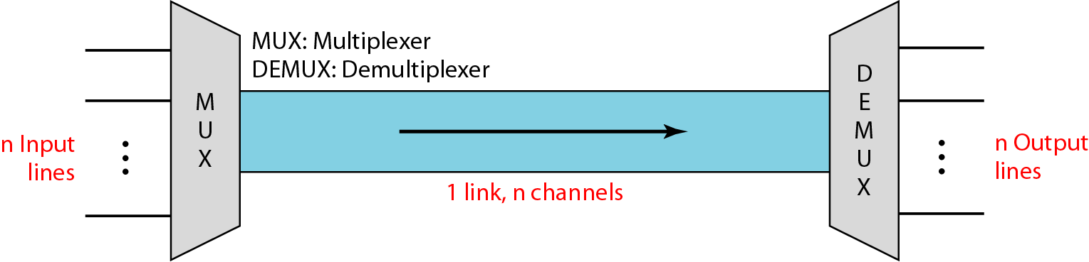
6-1 MULTIPLEXING
Figure 6.1 Dividing a link into channels
Julia Rahman, Dept. CSE, RUET

Slide 5
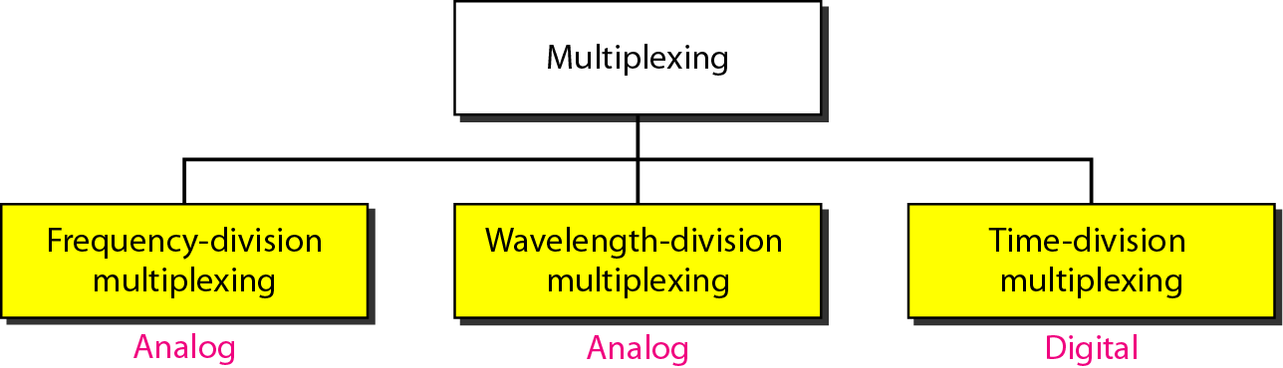
6-1 MULTIPLEXING
Figure 6.2 Categories of multiplexing
Julia Rahman, Dept. CSE, RUET

Slide 6
6-1 MULTIPLEXING
Frequency Division Multiplexing (FDM)
An analog technique that can be applied when the bandwidth of a link (in hertz) is greater than the combined bandwidths of the signals to be transmitted.
Signals generated by each sending device modulate different carrier frequencies.
Modulated signals are then combined into a single composite signal that can be transported by the link.
Carrier frequencies are separated by sufficient bandwidth to accommodate the modulated signal.
Channels can be separated by strips of unused bandwidth-guard bands to prevent signals from overlapping.
Julia Rahman, Dept. CSE, RUET

Slide 7
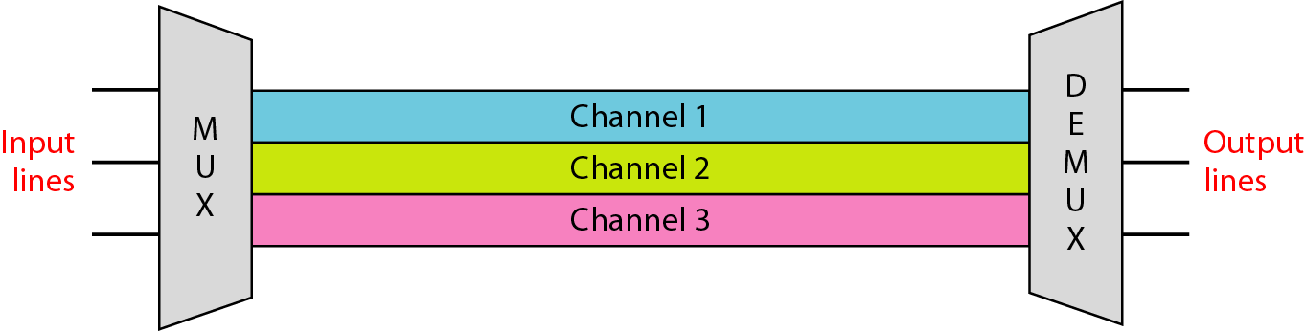
6-1 MULTIPLEXING
Figure 6.3 Frequency-division multiplexing (FDM)
Julia Rahman, Dept. CSE, RUET

Slide 8
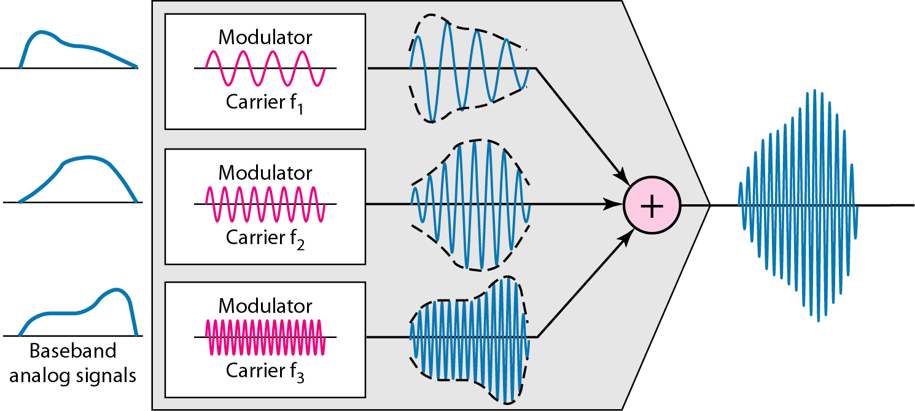
6-1 MULTIPLEXING
Frequency Division Multiplexing (FDM) Process
Figure 6.4 FDM process
Julia Rahman, Dept. CSE, RUET

Slide 9
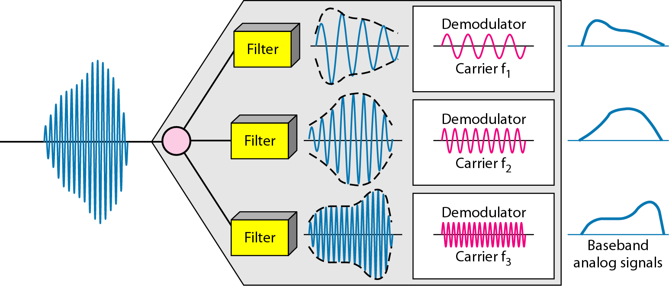
6-1 MULTIPLEXING
Frequency Division Multiplexing (FDM) Process
Figure 6.5 FDM demultiplexing example
Julia Rahman, Dept. CSE, RUET

Slide 10
6-1 MULTIPLEXING
Example 6.1
Assume that a voice channel occupies a bandwidth of 4 kHz. We need to combine three voice channels into a link with a bandwidth of 12 kHz, from 20 to 32 kHz. Show the configuration, using the frequency domain. Assume there are no guard bands.
Solution
We shift (modulate) each of the three voice channels to a different bandwidth, as shown in Figure 6.6. We use the 20- to 24-kHz bandwidth for the first channel, the 24- to 28-kHz bandwidth for the second channel, and the 28- to 32-kHz bandwidth for the third one. Then we combine them as shown in Figure 6.6.
Julia Rahman, Dept. CSE, RUET

Slide 11
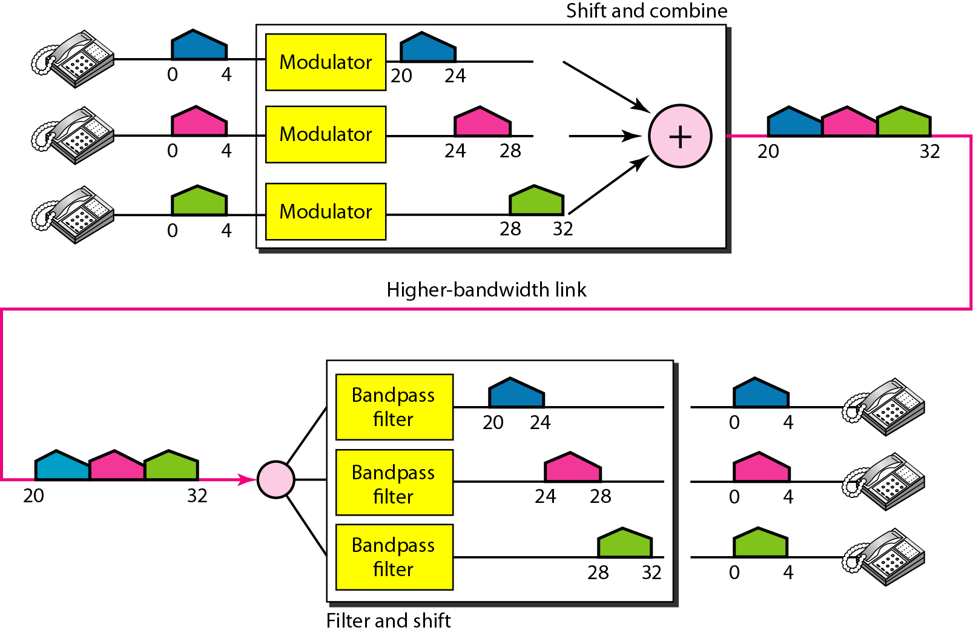
6-1 MULTIPLEXING
Example 6.1
Figure 6.6 Example 6.1
Julia Rahman, Dept. CSE, RUET

Slide 12
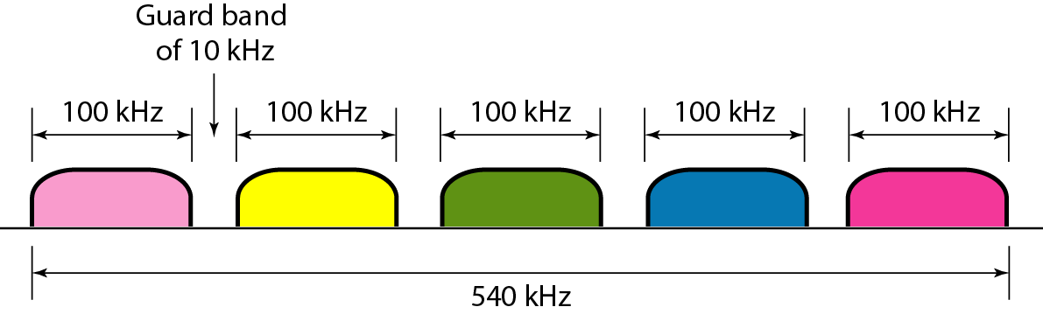
6-1 MULTIPLEXING
Example 6.2
Five channels, each with a 100-kHz bandwidth, are to be multiplexed together. What is the minimum bandwidth of the link if there is a need for a guard band of 10 kHz between the channels to prevent interference?
Solution
For five channels, we need at least four guard bands. This means that the required bandwidth is at least
5 × 100 + 4 × 10 = 540 kHz, as shown in Figure.
Julia Rahman, Dept. CSE, RUET

Slide 13
6-1 MULTIPLEXING
Application of Frequency Division Multiplexing (FDM)
AM and FM radio broadcasting
530 to 1700 kHz is assigned to AM radio
All radio stations need to share this band
Each station uses a different carrier frequency
FM has a wider band of 88 to 108 MHz because each station needs a bandwidth of 200 kHz
Television broadcasting
Each TV channel has its own bandwidth of 6 MHz
First generation of cellular telephones (still in operation) also uses FDM.
Julia Rahman, Dept. CSE, RUET

Slide 14
6-1 MULTIPLEXING
Wave-length Division Multiplexing (WDM)
WDM is an analog multiplexing technique to combine optical signals.
Designed to use the high-data-rate capability of fiber-optic cable.
Multiplexing allows us to combine several lines into one.
WDM is conceptually the same as FDM, except that the multiplexing and demultiplexing involve optical signals transmitted through fiber-optic channels.
The idea is the same: combining different signals of different frequencies.
The difference is that the frequencies are very high.
Julia Rahman, Dept. CSE, RUET

Slide 15
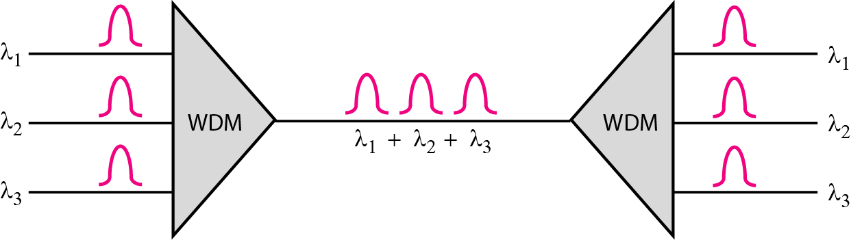
6-1 MULTIPLEXING
Figure 6.10 Wavelength-division multiplexing (WDM)
Julia Rahman, Dept. CSE, RUET

Slide 16
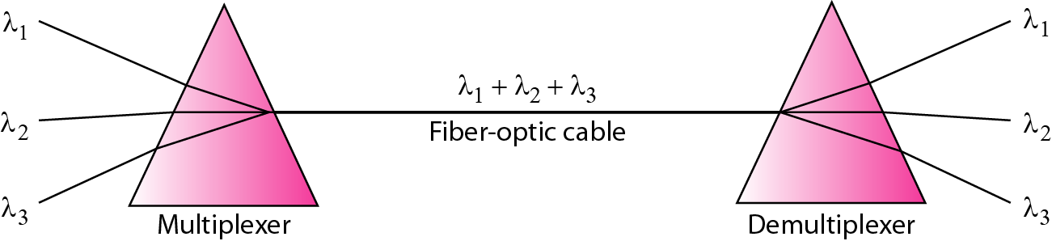
6-1 MULTIPLEXING
Figure 6.11 Prisms in wavelength-division multiplexing and demultiplexing
Julia Rahman, Dept. CSE, RUET

Slide 17
6-1 MULTIPLEXING
Application of Wave-length Division Multiplexing (WDM)
SONET network in which multiple optical fiber lines are multiplexed and demultiplexed.
Dense WDM (DWDM), can multiplex a very large number of channels by spacing channels very close to one another. It achieves even greater efficiency.
Julia Rahman, Dept. CSE, RUET

Slide 18
6-1 MULTIPLEXING
Time Division Multiplexing (TDM)
A digital process allows several connections to share the high bandwidth of a link.
Instead of sharing a portion of the bandwidth as in FDM, time is shared.
Each connection occupies a portion of time in the link.
TDM is combining several low-rate digital channels into one high-rate one.
In the figure, portions of signals 1, 2, 3, and 4 occupy the link sequentially.
Julia Rahman, Dept. CSE, RUET

Slide 19
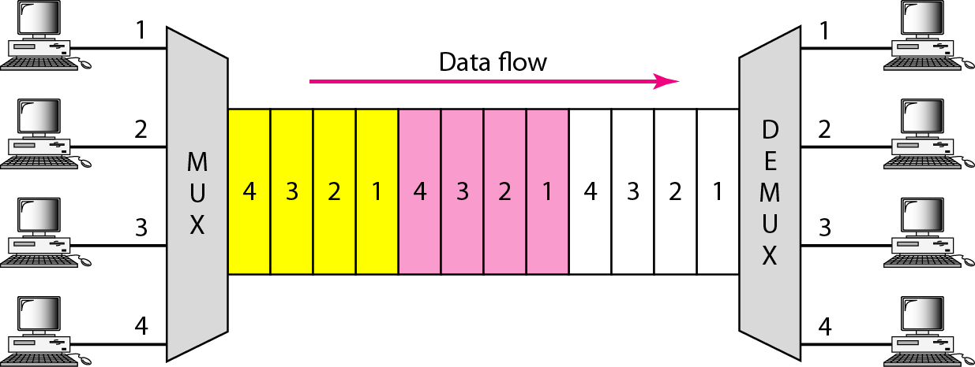
6-1 MULTIPLEXING
Figure 6.12 Time Division Multiplexing (TDM)
Julia Rahman, Dept. CSE, RUET

Slide 20
6-1 MULTIPLEXING
Synchronous Time Division Multiplexing
In synchronous TDM, the data flow of each input connection is divided into units, where each input occupies one input time slot.
A unit can be 1 bit, one character, or one block of data.
Each input unit becomes one output unit and occupies one output time slot.
In synchronous TDM, the data rate of the link is n times faster, and the unit duration is n times shorter.
Julia Rahman, Dept. CSE, RUET

Slide 21
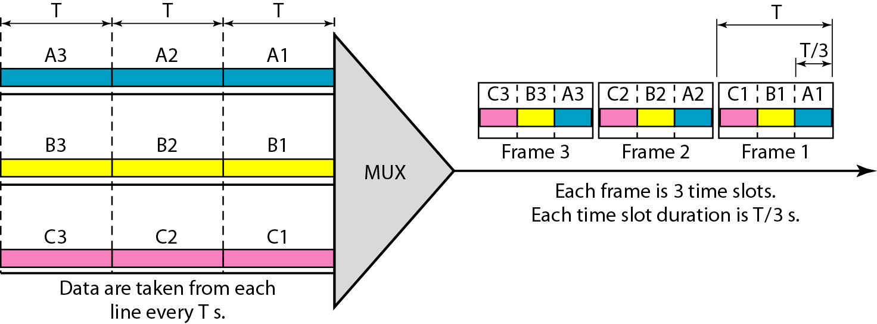
6-1 MULTIPLEXING
Figure 6.13 Synchronous time-division multiplexing
Julia Rahman, Dept. CSE, RUET

Slide 22
6-1 MULTIPLEXING
Example 6.5
In Figure 6.13, the data rate for each one of the 3 input connection is 1 kbps. If 1 bit at a time is multiplexed (a unit is 1 bit), what is the duration of (a) each input slot, (b) each output slot, and (c) each frame?
Solution
We can answer the questions as follows:
The data rate of each input connection is 1 kbps. This means that the bit duration is 1/1000 s or 1 ms. The duration of the input time slot is 1 ms (same as bit duration).
The duration of each output time slot is one-third of the input time slot. This means that the duration of the output time slot is 1/3 ms.
Each frame carries three output time slots. So the duration of a frame is 3 × 1/3 ms, or 1 ms.
Note: The duration of a frame is the same as the duration of an input unit.
Julia Rahman, Dept. CSE, RUET

Slide 23
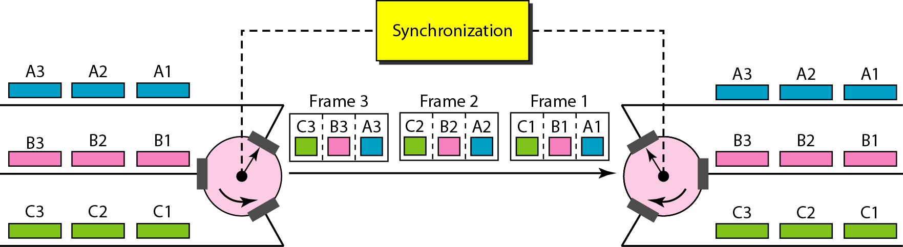
6-1 MULTIPLEXING
Interleaving
The process of taking a group of bits from each input line for multiplexing is called interleaving.
We interleave bits (1 - n) from each input onto one output.
Figure 6.15 Interleaving
Fast rotating switch
Julia Rahman, Dept. CSE, RUET

Slide 24
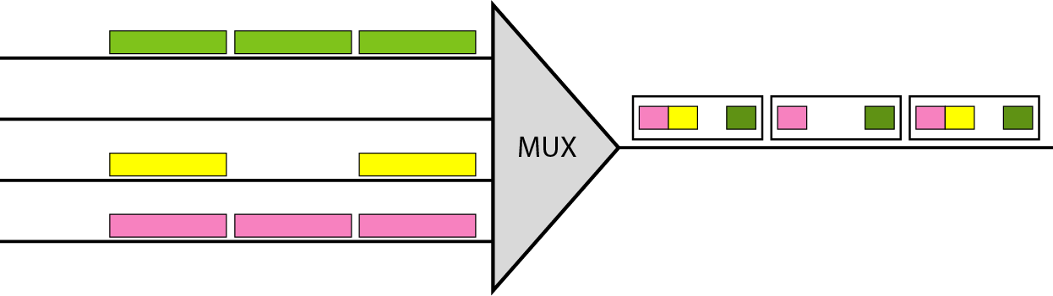
6-1 MULTIPLEXING
Empty Slots
Synchronous TDM is not as efficient because if a source does not have data to send, the corresponding slot in the output frame is empty.
That is wasteful of bandwidth
Figure 6.18 Empty slots
Julia Rahman, Dept. CSE, RUET

Slide 25
6-1 MULTIPLEXING
Data Rate Management
Not all input links maybe have the same data rate.
Some links maybe slower. There maybe several different input link speeds
There are three strategies that can be used to overcome the data rate mismatch: multilevel, multi-slot and pulse stuffing
Julia Rahman, Dept. CSE, RUET

Slide 26
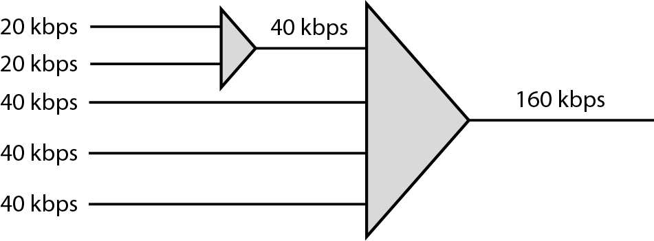
6-1 MULTIPLEXING
Multilevel Multiplexing
Multilevel multiplexing is a technique used when the data rate of an input line is a multiple of others.
Figure 6.19 Multilevel multiplexing
Julia Rahman, Dept. CSE, RUET

Slide 27
6-1 MULTIPLEXING
Multiple-Slot Allocation
Used when there is a GCD between the data rates.
The higher bit rate channels are allocated more slots per frame, and the output frame rate is a multiple of each input link.
A serial-to-parallel converter in the line to make two inputs out of one.
Julia Rahman, Dept. CSE, RUET

Slide 28
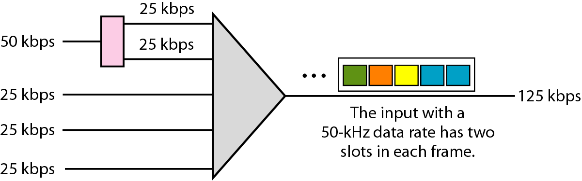
6-1 MULTIPLEXING
Figure 6.20 Multiple-slot multiplexing
Julia Rahman, Dept. CSE, RUET

Slide 29
6-1 MULTIPLEXING
Pulse Stuffing
Sometimes the bit rates of sources are not multiple integers of each other.
Therefore, neither of the above two techniques can be applied.
One solution is to make the highest input data rate the dominant data rate and then add dummy bits to the input lines with lower rates. This will increase their rates.
This technique is called pulse stuffing, bit padding, or bit stuffing.
Julia Rahman, Dept. CSE, RUET

Slide 30
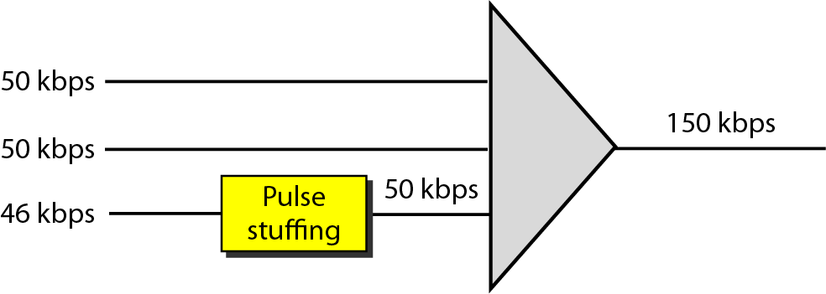
6-1 MULTIPLEXING
Figure 6.21 Pulse stuffing
Julia Rahman, Dept. CSE, RUET

Slide 31
6-1 MULTIPLEXING
Frame Synchronizing
If the. multiplexer and the demultiplexer are not synchronized, a bit belonging to one channel may be received by the wrong channel.
To ensure that the receiver correctly reads the incoming bits, i.e., knows the a incoming bit boundaries to interpret a “1” and “0”, a known bit pattern is used between the frames.
The receiver looks for the anticipated bit and starts counting bits till the end of the frame.
Then it starts over again with the reception of another known bit.
These bits (or bit patterns) are called synchronization bit(s).
They are part of the overhead of transmission.
Julia Rahman, Dept. CSE, RUET

Slide 32
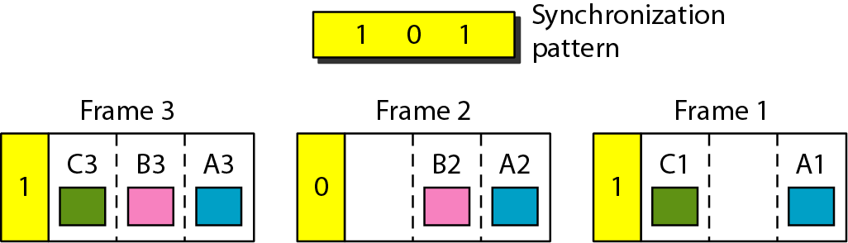
6-1 MULTIPLEXING
Figure 6.22 Framing bits
Julia Rahman, Dept. CSE, RUET

Slide 33
6-1 MULTIPLEXING
Application of Synchronous TDM
Some second-generation cellular telephone companies use synchronous TDM.
Using TDM, the number of telephone users in each area is now 6 times greater.
Julia Rahman, Dept. CSE, RUET

Slide 34
6-1 MULTIPLEXING
Statistical Time Division Multiplexing
In statistical time-division multiplexing, slots are dynamically allocated to improve bandwidth efficiency.
Only when an input line has a slot's worth of data to send is it given a slot in the output frame.
In statistical multiplexing, the number of slots in each frame is less than the number of input lines.
The multiplexer checks each input line in round-robin fashion; it allocates a slot for an input line if the line has data to send; otherwise, it skips the line and checks the next line.
Julia Rahman, Dept. CSE, RUET

Slide 35
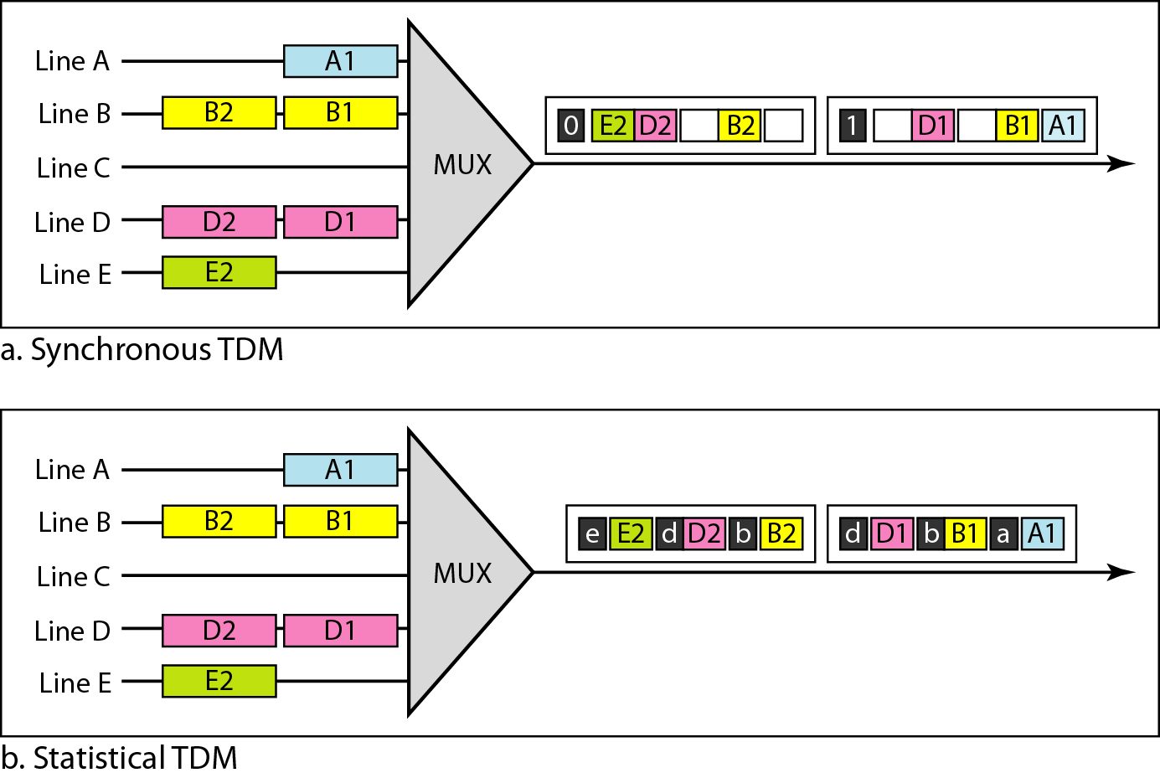
6-1 MULTIPLEXING
Figure 6.26 TDM slot comparison
Julia Rahman, Dept. CSE, RUET

Slide 36
6-1 MULTIPLEXING
Addressing
An output slot in synchronous TDM is totally occupied by data; in statistical TDM, a slot needs to carry data as well as the address of the destination.
In synchronous TDM, there is no need for addressing; synchronization and pre-assigned relationships between the inputs and outputs serve as an address.
Slot Size
Since a slot carries both data and an address in statistical TDM, the ratio of the data size to address size must be reasonable to make transmission efficient.
For example, it would be inefficient to send 1 bit per slot as data when the address is 3 bits. In statistical TDM, a block of data is usually many bytes while the address is just a few bytes.
Julia Rahman, Dept. CSE, RUET

Slide 37
6-1 MULTIPLEXING
No Synchronization Bit
There is another difference between synchronous and statistical TDM, is at the frame level.
The frames in statistical TDM need not be synchronized, so we do not need synchronization bits.
Bandwidth
In statistical TDM, the capacity of the link is normally less than the sum of the capacities of each channel.
The designers of statistical TDM define the capacity of the link based on the statistics of the load for each channel.
Julia Rahman, Dept. CSE, RUET

Slide 38
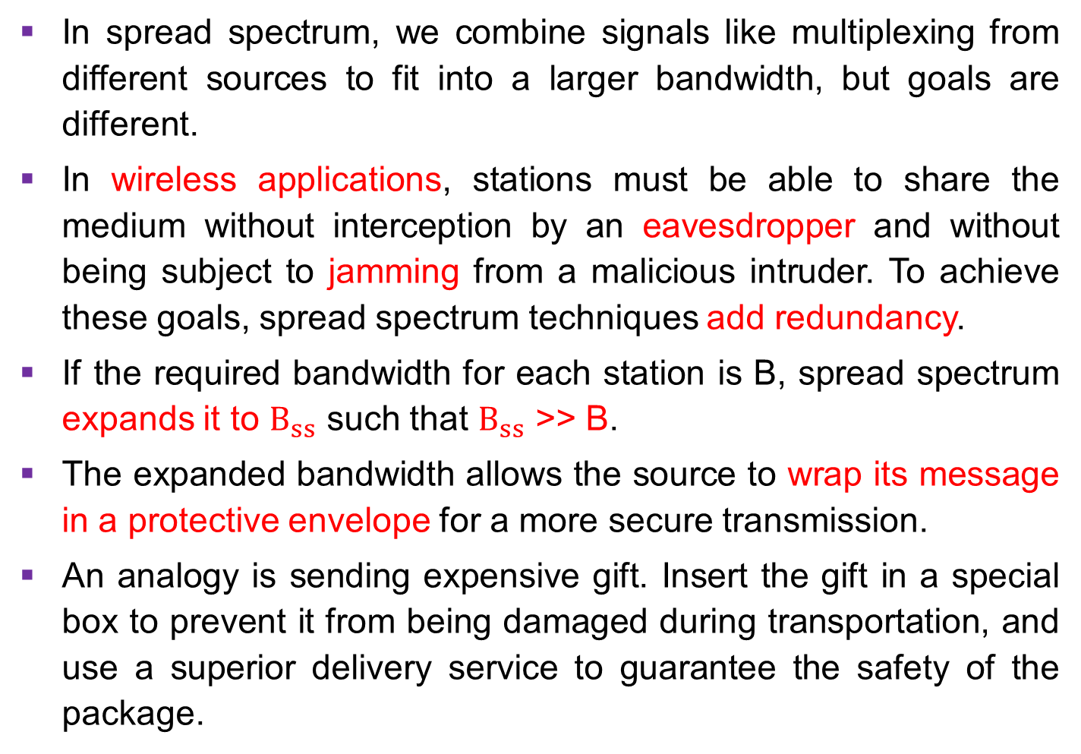
6-2 SPREAD SPECTRUM
In spread spectrum, we combine signals like multiplexing from different sources to fit into a larger bandwidth, but goals are different.
In wireless applications, stations must be able to share the medium without interception by an eavesdropper and without being subject to jamming from a malicious intruder. To achieve these goals, spread spectrum techniques add redundancy.
If the required bandwidth for each station is B, spread spectrum expands it to $B_{ss}$ such that $B_{ss}$ >> B.
The expanded bandwidth allows the source to wrap its message in a protective envelope for a more secure transmission.
An analogy is sending expensive gift. Insert the gift in a special box to prevent it from being damaged during transportation, and use a superior delivery service to guarantee the safety of the package.
Julia Rahman, Dept. CSE, RUET

Slide 39
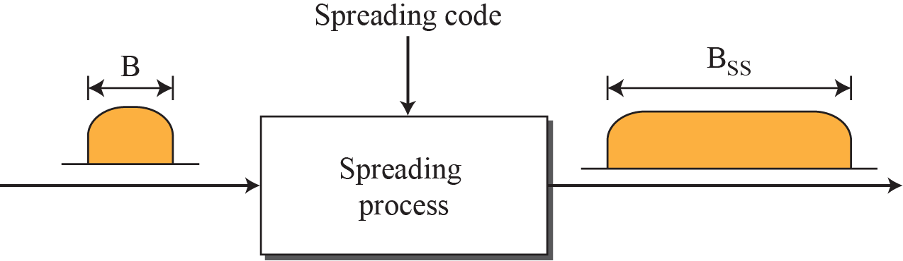
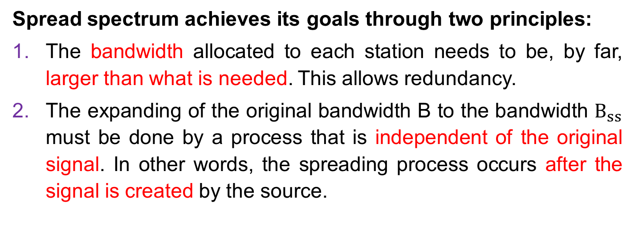
6-2 SPREAD SPECTRUM
Spread spectrum achieves its goals through two principles:
The bandwidth allocated to each station needs to be, by far, larger than what is needed. This allows redundancy.
The expanding of the original bandwidth B to the bandwidth $B_{ss}$ must be done by a process that is independent of the original signal. In other words, the spreading process occurs after the signal is created by the source.
Julia Rahman, Dept. CSE, RUET

Slide 40
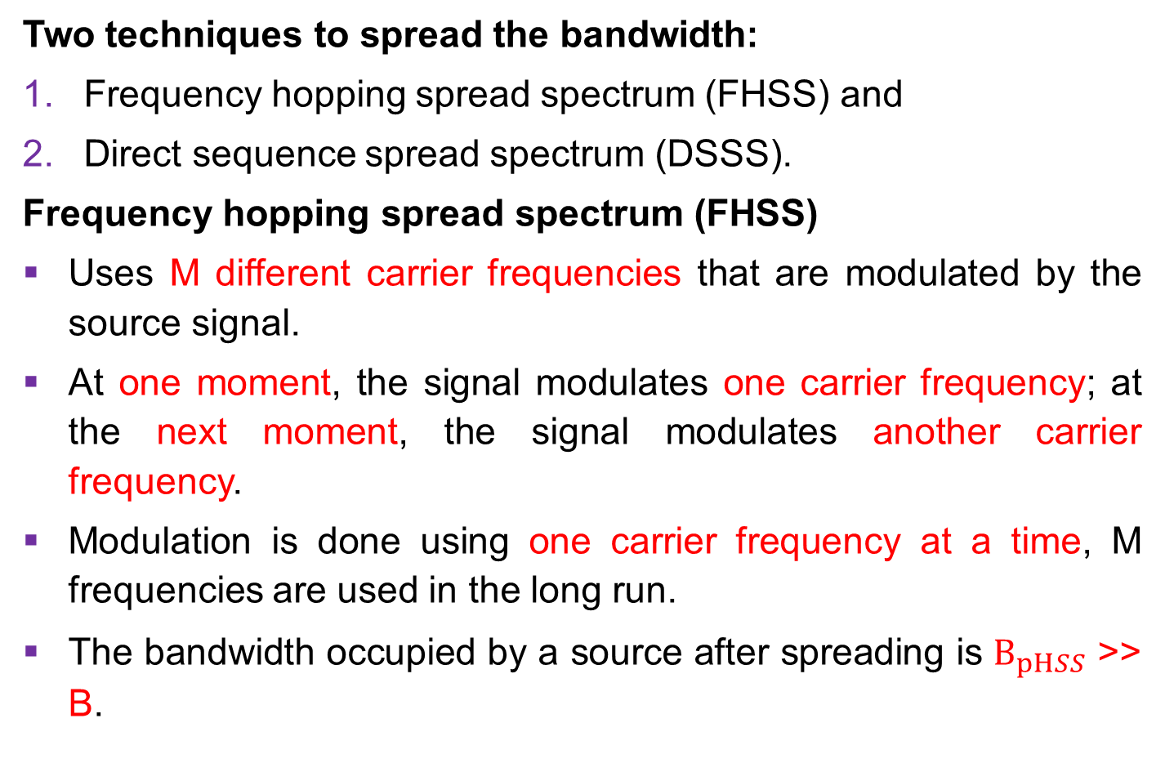
6-2 SPREAD SPECTRUM
Two techniques to spread the bandwidth:
Frequency hopping spread spectrum (FHSS) and
Direct sequence spread spectrum (DSSS).
Frequency hopping spread spectrum (FHSS)
Uses M different carrier frequencies that are modulated by the source signal.
At one moment, the signal modulates one carrier frequency; at the next moment, the signal modulates another carrier frequency.
Modulation is done using one carrier frequency at a time, M frequencies are used in the long run.
The bandwidth occupied by a source after spreading is $B_{pHSS}$ >> B.
Julia Rahman, Dept. CSE, RUET

Slide 41
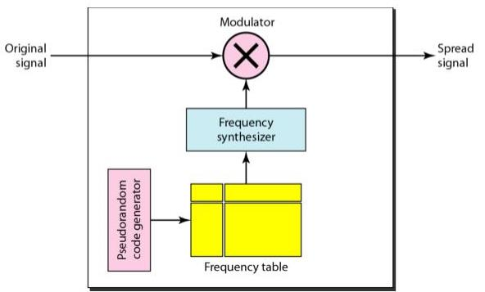
6-2 SPREAD SPECTRUM
Figure 6.28 Frequency hopping spread spectrum (FHSS)
Julia Rahman, Dept. CSE, RUET

Slide 42
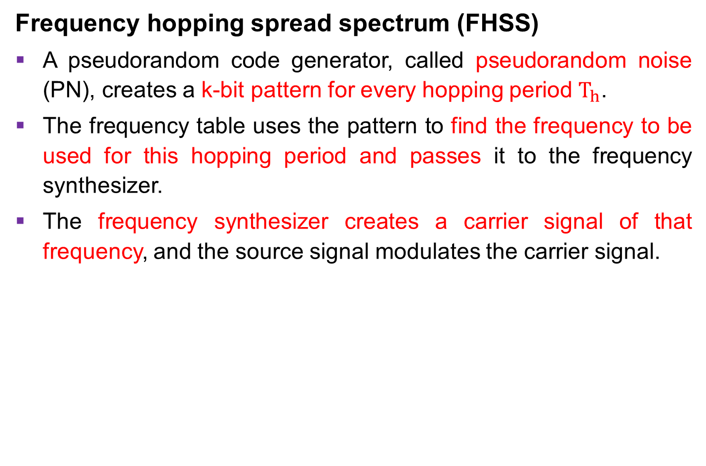
6-2 SPREAD SPECTRUM
Frequency hopping spread spectrum (FHSS)
A pseudorandom code generator, called pseudorandom noise (PN), creates a k-bit pattern for every hopping period $T_{h}$.
The frequency table uses the pattern to find the frequency to be used for this hopping period and passes it to the frequency synthesizer.
The frequency synthesizer creates a carrier signal of that frequency, and the source signal modulates the carrier signal.
Julia Rahman, Dept. CSE, RUET

Slide 43
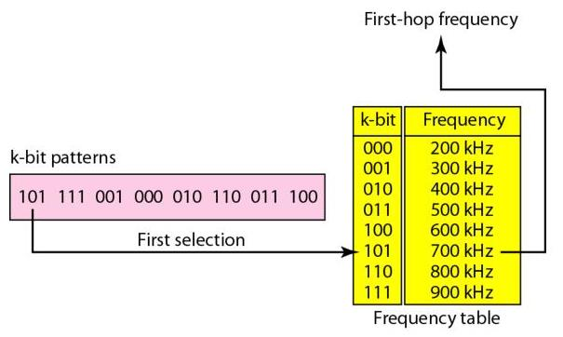
6-2 SPREAD SPECTRUM
Figure 6.29 Frequency selection in FHSS
Julia Rahman, Dept. CSE, RUET

Slide 44
6-2 SPREAD SPECTRUM
Direct Sequence Spread Spectrum
The direct sequence spread spectrum (DSSS) technique also expands the bandwidth of the original signal, but the process is different.
In DSSS, we replace each data bit with n bits using a spreading code.
In other words, each bit is assigned a code of n bits, called chips, where the chip rate is n times that of the data bit.
Julia Rahman, Dept. CSE, RUET

Slide 45
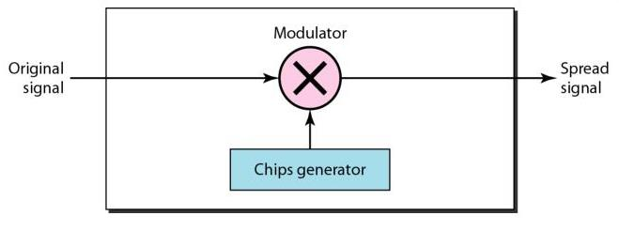
6-2 SPREAD SPECTRUM
Figure 6.32 DSSS
Julia Rahman, Dept. CSE, RUET

Slide 46
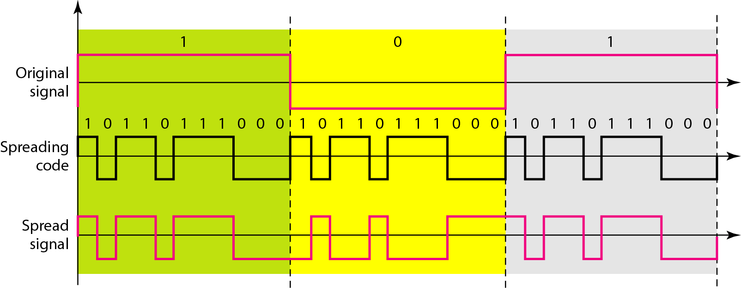
6-2 SPREAD SPECTRUM
Direct Sequence Spread Spectrum
Figure 6.32 DSSS example
Julia Rahman, Dept. CSE, RUET

